Slide 1
Validity of BMI as a measure of obesity
V. P. Wickramasinghe, G. J. Cleghorn, K. A. Edmiston, A. J. Murphy, R. A. Abbott & P. S. W. Davies (2005) Validity of BMI as a measure of obesity in Australian white Caucasian and Australian Sri Lankan children, Annals of Human Biology, 32:1, 60-71, DOI: 10.1080/03014460400027805

Slide 2
Introduction
Background
Subjects and methods
Results
Conclusions

Slide 3
Description and interpretations of test scores
BMI & FM
BMI & %FM
BMI-Z & FM
BMI-Z & %FM
Validity and accuracy
Multiple linear regression

Slide 4
Categorization of validation processes
Evidence Based on Test Content
Evidence Based on Response Processes
Evidence Based on Internal Structure
Evidence Based on Relations to Other Variables
Evidence for Validity and Consequences of Testing

Slide 5
Description of results
Table I. Physical characteristics of the study population
Table II. Correlation coefficient (r) and level og significance of the relationship between BMI and other indices of body composition
Table III. Cases of obesity and overweight diagnosed by the difference criteria
Table IV. Validity of BMI as an indicator of obesity (%)
Table V. Multiple regression analysis to assess the influence of ethnic origin on the relationship between %FM and BMI-Z score.

Slide 6
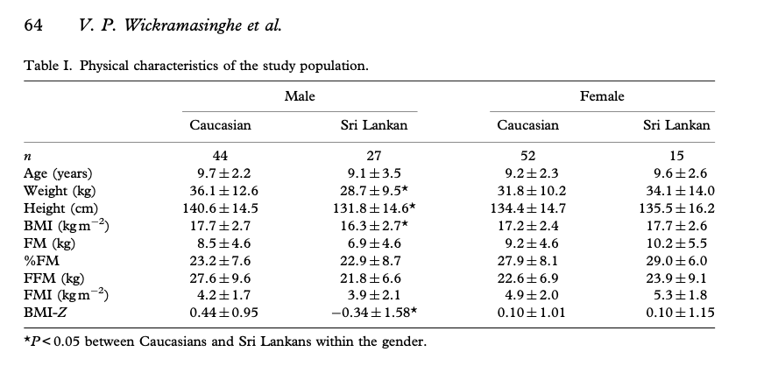
Table I. Physical characteristics of the study population

Slide 7
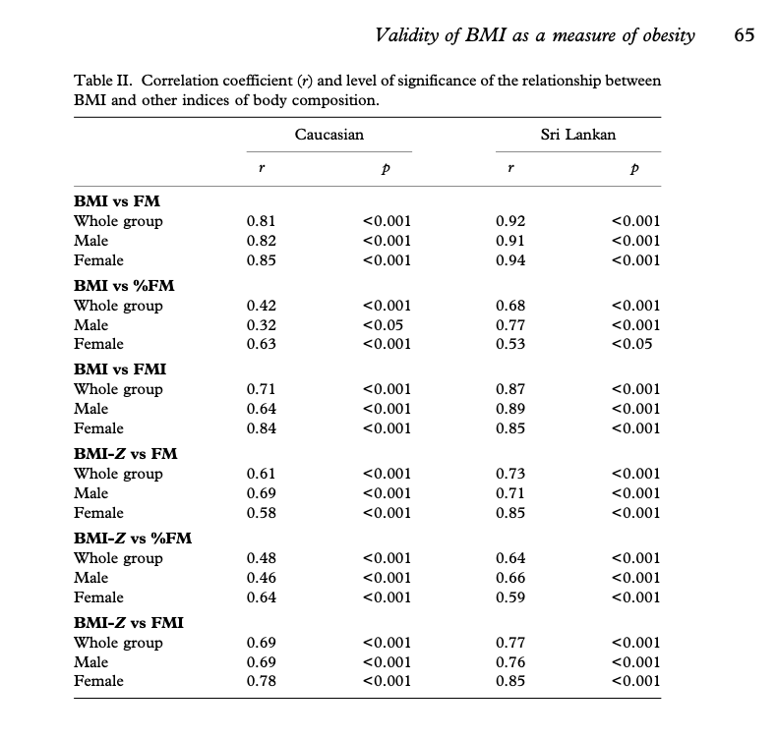
Table II. Correlation coefficient (r) and level og significance of the relationship between BMI and other indices of body composition

Slide 8
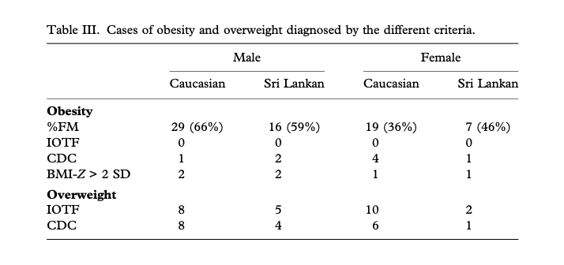
Table III. Cases of obesity and overweight diagnosed by the difference criteria

Slide 9
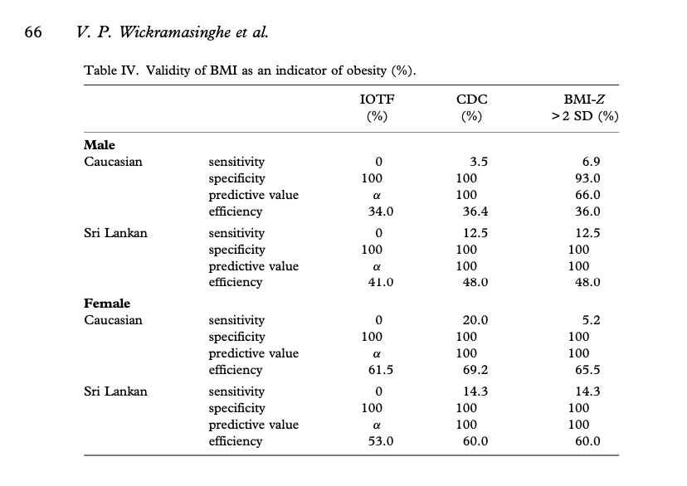
Table IV. Validity of BMI as an indicator of obesity (%)

Slide 10
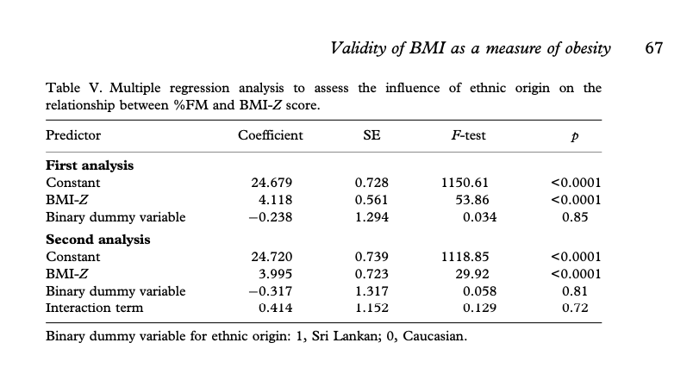
Table V. Multiple regression analysis to assess the influence of ethnic origin on the relationship between %FM and BMI-Z score.

Slide 11
BMI is bad, but …

